Slide 1
Wellbeing in Primary School Leadership “Nurturing Self and the team”
Lorraine Dempsey
St Patrick’s National School Wicklow
Notes:
My journey!

Slide 2
"A healthy leader creates a thriving team."
Notes:
Brief introduction to the importance of well-being in leadership.

Slide 3
Enhanced Decision-Making:
Well-being empowers leaders to make clear and thoughtful decisions.
Stress-free minds lead to better problem-solving and strategic thinking.
Increased Productivity:
Healthy leaders are more productive and can inspire the same in their teams.
Reduced absenteeism and increased engagement contribute to overall productivity.

Slide 4
Positive Team Culture:
Leaders who prioritize well-being foster a positive and supportive team culture.
Improved morale and camaraderie contribute to a more collaborative work environment.
Resilience in the Face of Challenges:
Well-being equips leaders with the resilience to navigate challenges.
Overcoming adversity becomes more manageable with a strong foundation of well-being.

Slide 5
Role Modelling:
Leaders who prioritize their well-being set an example for their team members.
Demonstrating a commitment to self-care encourages others to do the same.

Slide 6
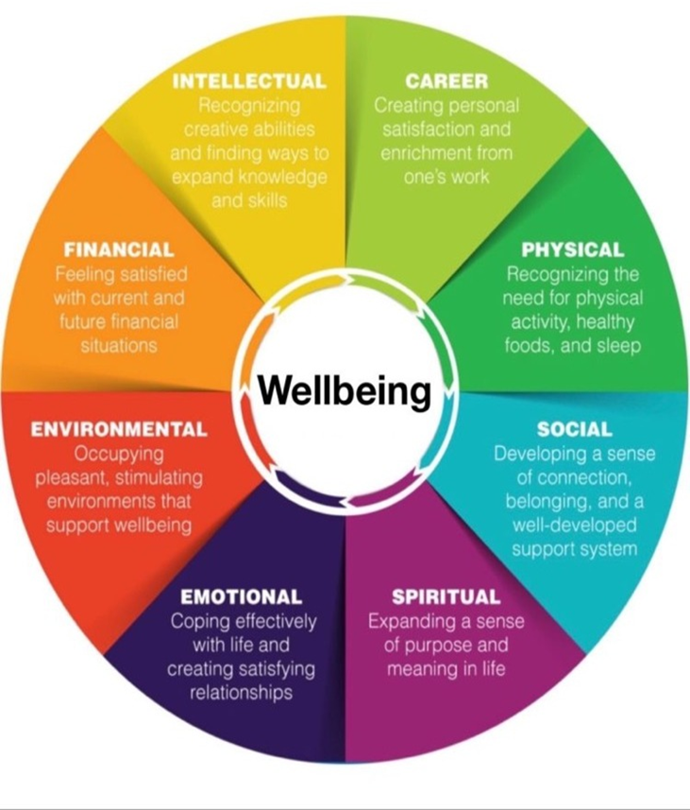

Slide 7
Notes:
A simple definition

Slide 8
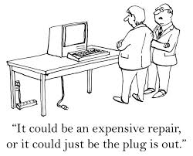
"The Demands of School Leadership"

Slide 9
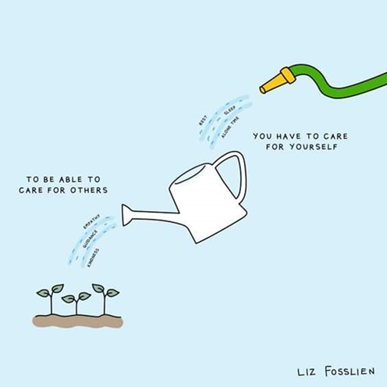
“Understanding the Impact"
In order for a school to thrive school and to improve student learning outcomes, you must first attend to your own wellbeing.
Notes:
Some research context also mention wellbeing framework etc…

Slide 10
Research consistently shows us that good school leadership not only matters - it impacts on pupil learning.
Research undertaken by the IPPN over the past year finds that the incidence of burnout, stress, and depressive symptoms among leaders is almost double that of the healthy working population.

Slide 11
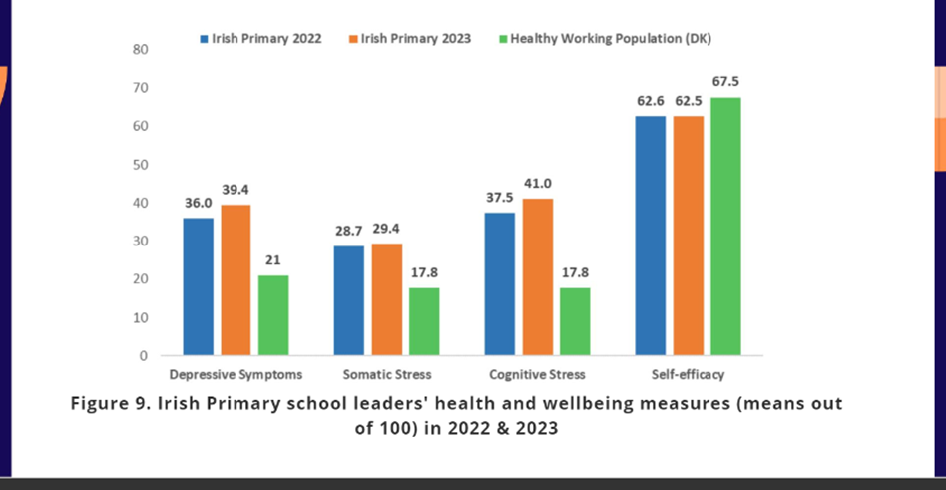
Self-rated health
Burnout
Stress symptoms
Difficulty sleeping
Depressive symptoms
Somatic symptoms
Cognitive stress
Self-efficacy

Slide 12
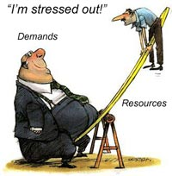
Stress comes from external and internal sources
Acceleration of change in our profession
Life around us is speeding up geometrically, like a merry-go-round accelerating out of control, leaving many of us feeling like we are barely hanging on.

Slide 13
Demands
Excessive workload
Lack of Support network
Policy changes
Lack of resources
Inadequate support and time for middle leadership

Slide 14
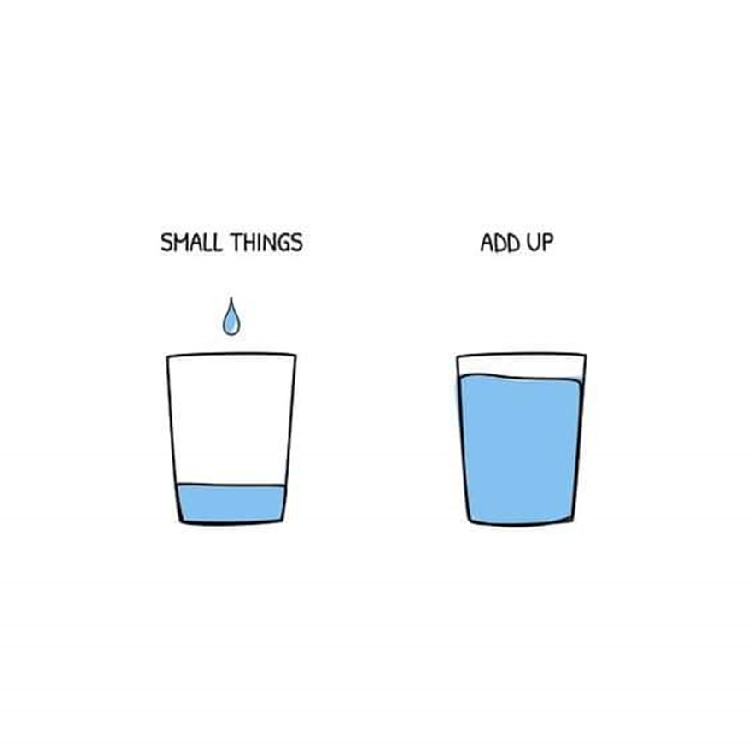
"Building a Resilient Leadership Team"
The Department of Education has publicly acknowledged on a number of occasions how essential effective school leadership is in effecting system change.

Slide 15
Individual well-being
Team cohesion and support
Organizational policies promoting wellbeing

Slide 16
Effective schools require a team of leaders, who utilise their collective intelligences to transform the school into a learning community. […] investment in the development of these teams is recommended to ensure that senior and middle leaders have the necessary skills to work well together.”

Slide 17
“Schools thrive when leaders thrive”
School leaders are charged with giving our school communities the best opportunities they can. That means thriving as educators and leaders, not merely surviving.
The Department of Education must look after the personal health & wellbeing of school leaders around this country. This is in the best interests of the children in our schools.

Slide 18
MLAR Project
Sharing of leadership is a necessity and not a luxury – failing to share leadership limits school effectiveness.
Leadership is not solely invested in the principal but leadership is exercised by different people, in different ways across a school to build and sustain the conditions for effective learning.

Slide 19
MLAR Project
Middle leaders seeing themselves as leaders, with working collaboratively with fellow leaders and teachers central to their role.
Forde recognises the intensive demands of having responsibility for a class can leave limited opportunities for leading.

Slide 20
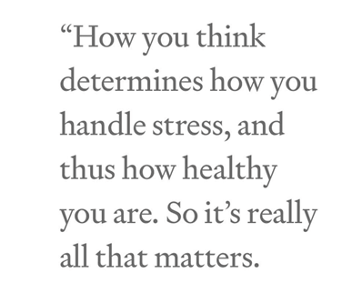
In order for to lead effectively and to improve student learning outcomes, you must first attend to your own wellbeing.
How you perform will dictate the outcome.

Slide 21
"Self-Care Strategies for Leaders"
Work-life balance
Stress management techniques
Importance of self-reflection and mindfulness
Availing of professional opportunities for the leadership and management team – team coaching, Forbairt, Comhar…

Slide 22
"Fostering a Supportive Team Culture"
Finding creative ways to ‘release’ the deputy principal so that we can have structured time to work and plan together
Prioritising the facilitation of the deputy’s professional development
Encouraging the deputy to collaborate with other deputies and to participate in local support groups
Recognising the potential of the relationship between principal and deputy principal to model a culture of effective shared leadership.

Slide 23
"Fostering a Supportive Team Culture"
Open communication
Collaborative decision-making
Recognizing and addressing signs of stress in team members
Professional development opportunities
Flexible work arrangements
Mental health resources and counselling services

Slide 24
"The Ripple Effect of a Healthy Team"
Improved job satisfaction
Enhanced team performance
Positive impact on school culture and student outcomes

Slide 25
Boundaries
Control
Permission

Slide 26
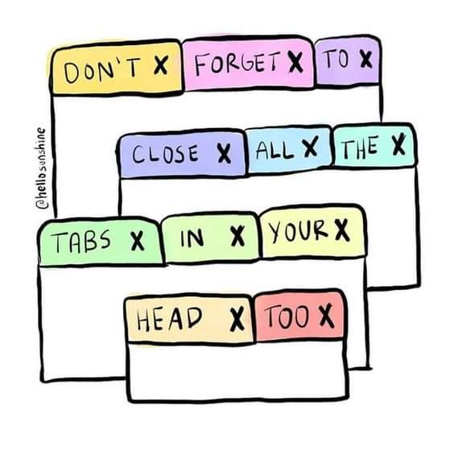

Slide 27
Recommended

